Slide 1

Online Shopping System
By- NIKITA KHAMKAR
ADBMS
Northeastern University

Slide 2
Purpose:
Currently businesses are facing challenges in the order management.
Keeping record of products, customers, supplier and orders is a huge task. An efficient database is a necessity in such a business.
Redundant data free database occupies less amount of space and works much efficiently. This project deals with the whole life cycle of the order management

Slide 3
Project Goals:
Associating the customer details to the customer id for effective storage and retrieval of the respective customer products.
Associating the orders table to product inventory so that when order is placed for particular products it reflects the available count of product in product inventory.
Also Linking the order return table with product inventory so that if order is returned, it again reflects the product availability count.
Manufacturer is linked with the product table

Slide 4
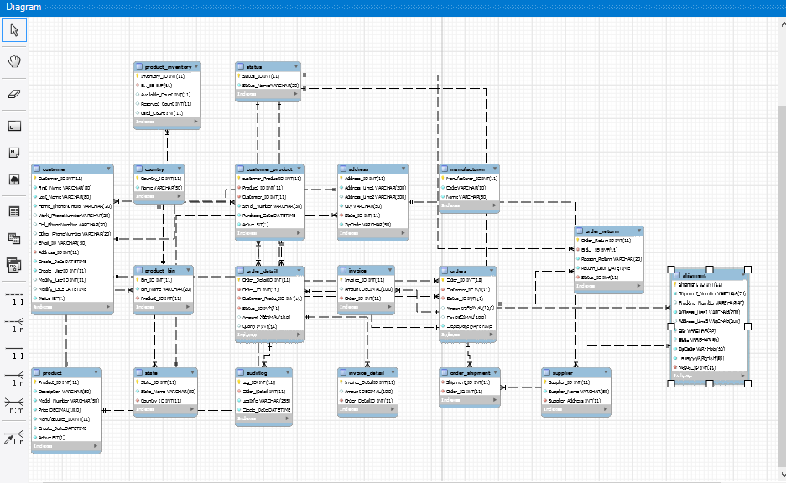
ER- Diagram

Slide 5
Demo

Slide 6
Data Base Security and Backup
For backup below script is used to backup my final_project_adbms database.
#mysqldump – u root – final_project_adbms > final_project_adbmsbackup.sql
With this script a backup file of database is created with new name.
Also, Data Export utility is available In Mysql for backup.

Slide 7
Contd..
GRANT option: Granting privileges is an important aspect of database security.
If you want to disable network access to your database server , use below command line skip-networking
We can delete the test database that is created by default in Mysql as this database is accessible to all anonymous users.
Drop database test
Use passwords for users created. This is most basic security.

Slide 8
Business Intelligence
By using the data in the database, the business user can look into
Sales of a particular product along with the profit
Highest selling products
Frequent customers of the company
Sales trend
Products by Manufacturer and available quantity

Slide 9
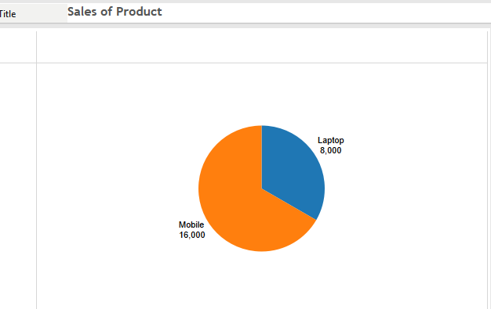
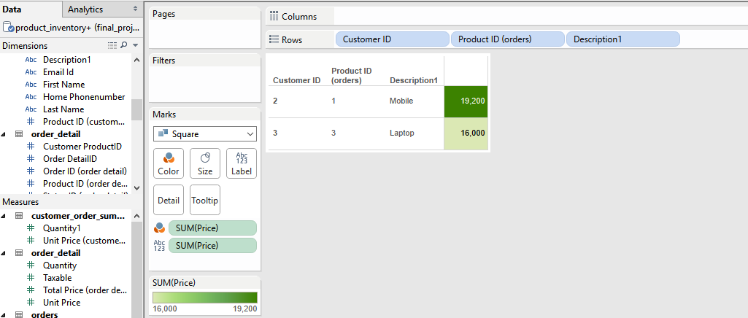
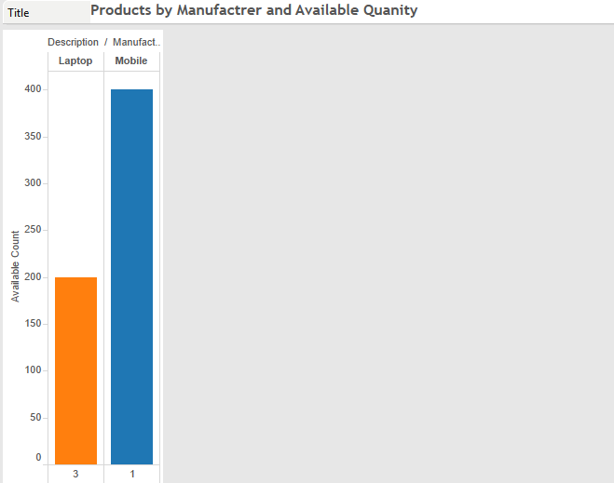
Visualization:

Slide 10
Conclusion:
The database is designed considering data integrity and security standards. The naming conventions are given as per standard rules and regulations. The database is designed using set business constraints and logic based upon the basic business requirements.

Slide 11
Thank You!

